Slide 1


EENG385 - Electronic Devices and Circuits
Lab 05:
Calibrating the BJT Curve Tracer
Objective:
Finish assembly of BJT Curve Tracer and use it to measure the gain and Early voltage of three BJTs.
1

Slide 2
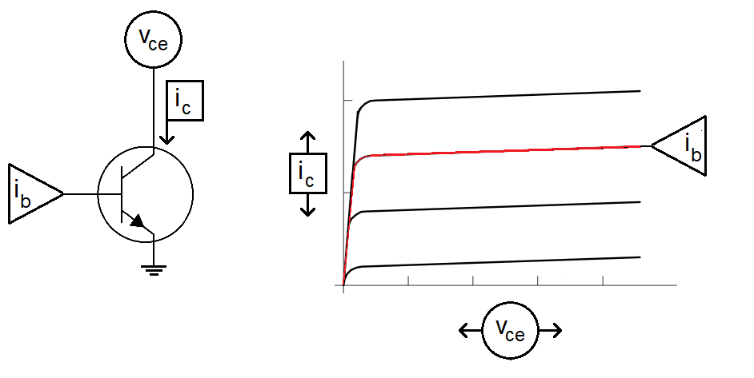
BJT Curve Tracer: Theory of Operation
Device Under Test = DUT
Draw family of characteristic curves on oscilloscope
Provide v_{ce} and i_{b} as inputs then measure i_{c} as the output
2
2
Notes:
2

Slide 3
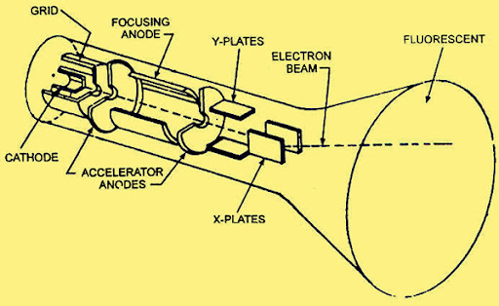
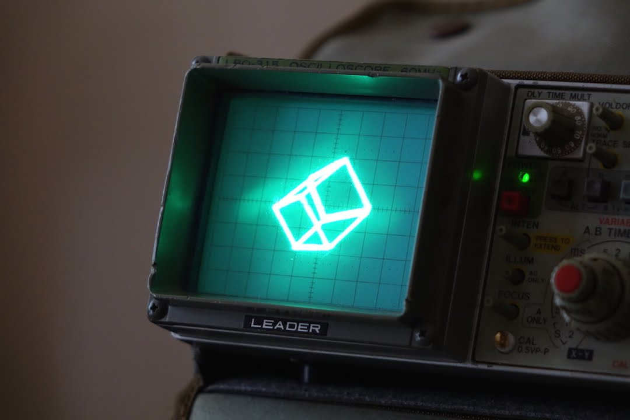
Theory :Oscilloscopes in X/Y mode
Imagine oscilloscope drawing an image using a beam
Oscilloscopes used CRTs
X-position of beam
Controlled by voltage on Ch1
Y-position of beam
Controlled by voltage on Ch2
Can create complex images
I_{C} vs. V_{CE} family of curves
3
3
Notes:
3

Slide 4
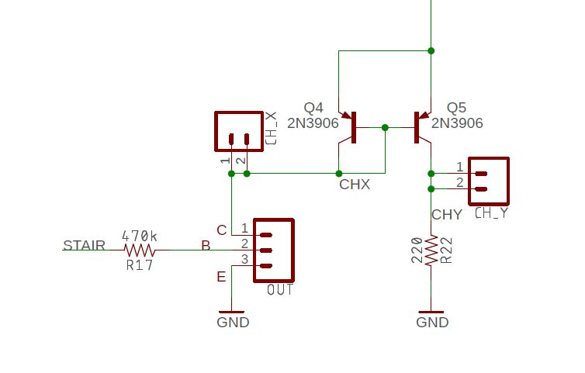
Axis Scale for BJT Curve Tracer
Ramp - 0.7V is applied to collector of DUT
Current mirror converts i_{c} into voltage across 220Ω
V_{STAIR} is converted to base current through 470kΩ
You will measure the voltage of each step convert to base current
You can do this before soldering in components
Step | V_{STAIR} | i_{b} (uA)
9 | 8.03 | 15.6
8 | 7.84 | 15.2
7 | 6.95 | 13.3
6 | 6.06 | 11.4
5 | 5.07 | 9.3
4 | 4.18 | 7.4
3 | 3.29 | 5.5
2 | 2.39 | 3.6
1 | 1.41 | 1.5
0 | 0V | 0
4
4
Notes:
4

Slide 5
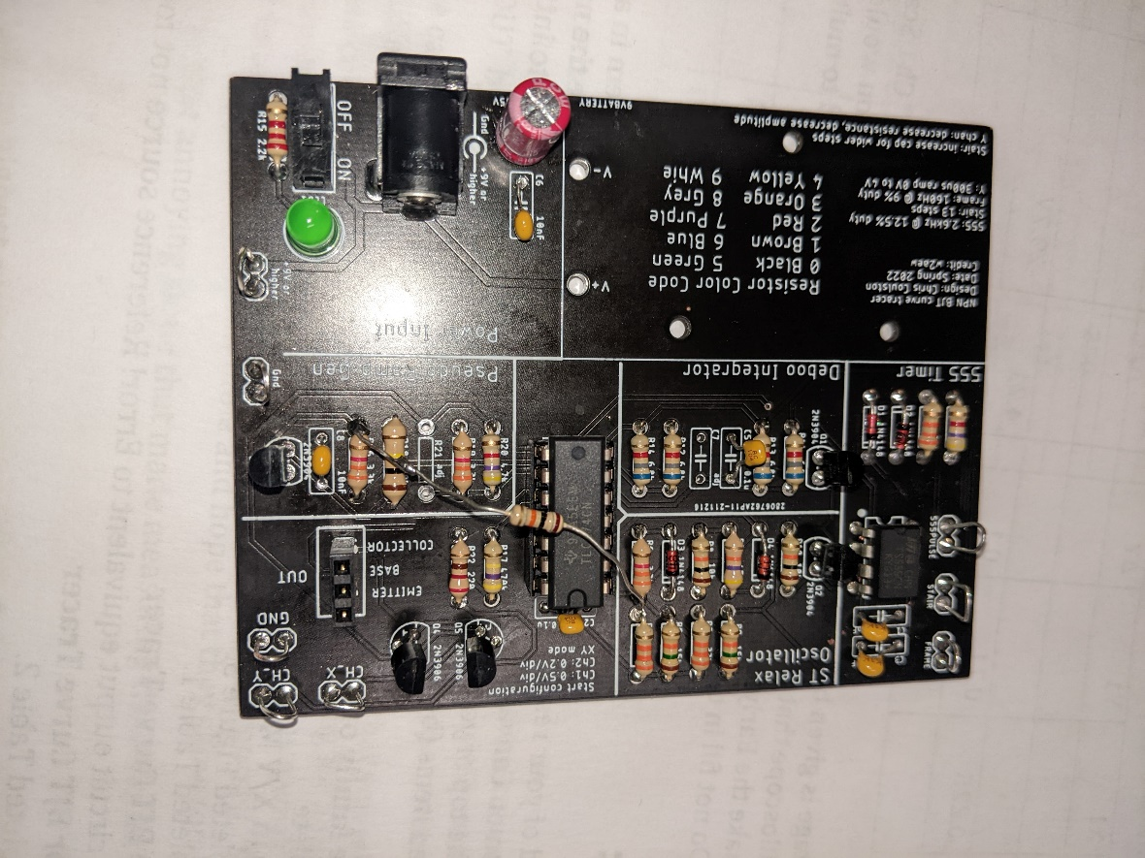
Assemble BJT Curve Tracer
Two 2N3906 PNP in 385 parts bin in brown cabinets along wall
One 2N3904 NPN in 385 parts bin
Misc. resistors and 3-pin DUT socket in your parts bag
Use resistor leads for GND, CH_X and CH_Y loops
5
5
Notes:
5

Slide 6
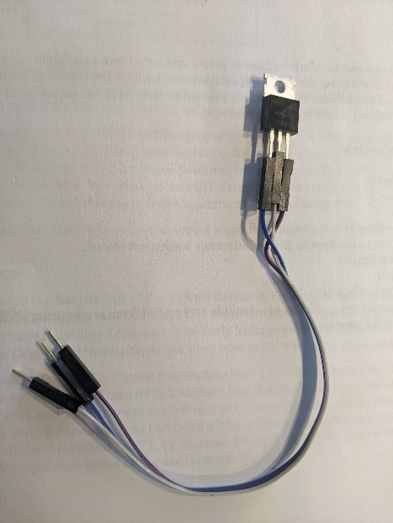
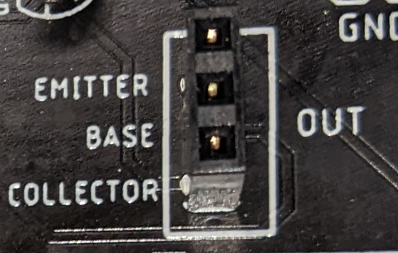
Inserting the DUT into Socket
Different BJTs will have different pinouts
Will not harm DUT BJT if you put it in backwards
Check datasheet for pinout
Use jumper wires as needed
6
6
Notes:
6

Slide 7
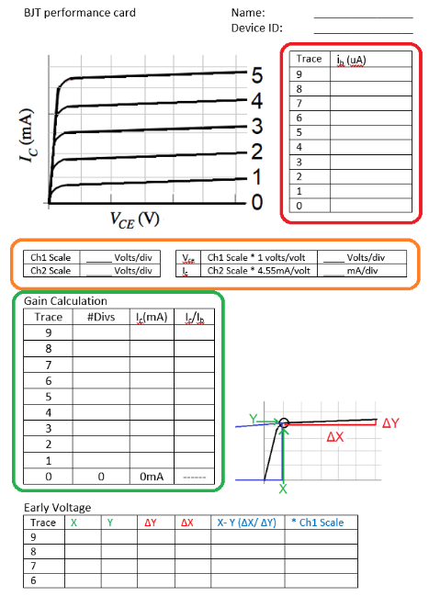
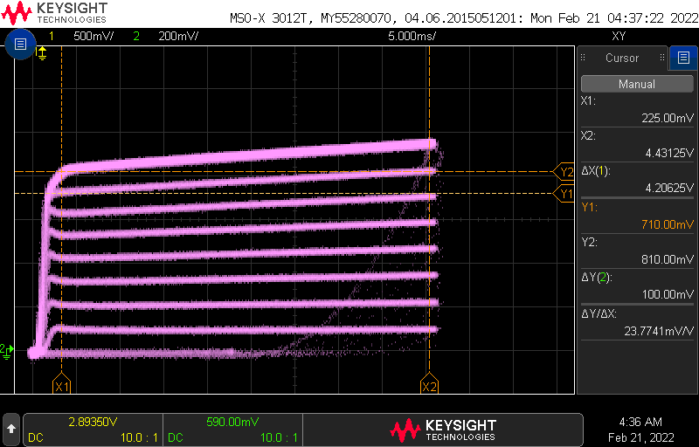
Filling out BJT Performance Card
Base current from Table
Scale from scope
Measure i_{c} at v_{ce} = 1V
Use cursors for Early voltage
7
7
Notes:
7

Slide 8
Turn in:
This is an individual assignment
You can work in teams of two during this lab
Fill out 3 BJT Performance Cards for:
2N2222 or 2N3904 (in 385 parts bin or Blue cabinet in 305)
BD139 or TIP41C (in 385 parts bin)
Random NPN BJT you find lying about
8
8
Notes:
8

